Slide 1

Project Presentation
Production of a profitable & prestigious movie
MGT 6203: Data Analytics in Business
Georgia Tech - EdX MicroMaster
Group 1 –
Joel Quek
Kevin Fong
Ho Wei Sin
Soo Wen Jun
Date 20 July 2023
Notes:
Wen Jun
Hi, we are Group 1 in the MGT 6203 Course for the Summer 2023 Semester
Today our presentation will be on production of a profitable & prestigious movie

Slide 2
Overview of Project
Notes:
Wen Jun

Slide 3

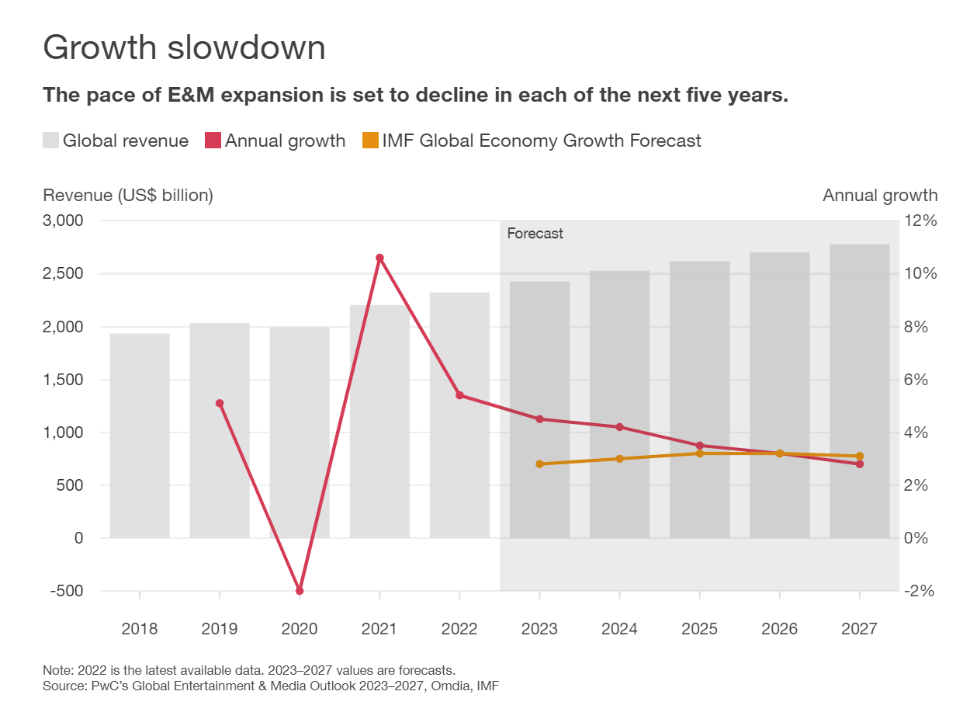
Decreasing Revenue growth rate for entertainment and media industry; Movies harder to obtain profitability
Total global entertainment and media (E&M) revenue rose 5.4% in 2022, to US$2.32 trillion. That represents a sharp deceleration from the 10.6% growth rate in 2021, when economies and industries globally were starting to rebound from the upheaval caused by the covid-19 pandemic.
PwC forecasts declining rate of growth for the next 5 years with terminal growth rate at 2.8%; lower than International Monetary Fund (“IMF”) projection of global economy growth at 3.1%
Notes:
Wen Jun
Based on a June 2023 study by PwC, Total global entertainment and media (E&M) revenue rose 5.4% in 2022, to US$2.32 trillion. Sharp deceleration from the 10.6% growth rate in 2021, when economies and industries globally were starting to rebound from the upheaval caused by the covid-19 pandemic.
And in each of the next five years, the rate of
growth will decline sequentially, so that by 2027 revenue will grow just 2.8% from 2026. That’s slower than the 3.1% rate of overall economic growth that the IMF projects for that year.

Slide 4
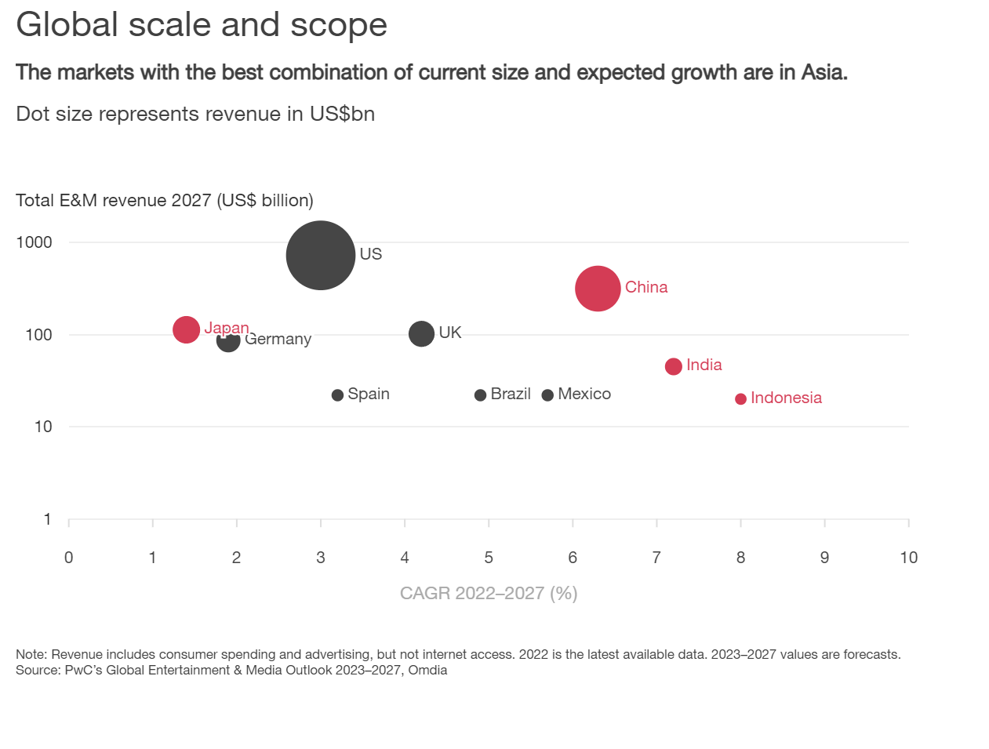
2x CAGR for next 5 years in Asia compared to US
We note that developing countries in Asia do have an exceedingly higher CAGR pertaining to Entertainment and Media revenue compared to the US.
This will allow us to leverage on the team’s geographical advantage of being in Singapore and develop profitable films in Asia
Notes:
Wen Jun
However, we note that further in its report, developing countries in Asia do have an exceedingly higher CAGR pertaining to Entertainment and Media Revenue compared to the US.
This will allow us to leverage on the team’s geographical advantage and develop profitable films in Asia

Slide 5
OBJECTIVE / PROBLEM
What movie should we make to maximise profit & its likelihood for winning a prestigious award (e.g. an Oscar)?
Background Information
Film industry is a highly competitive sector, with numerous factors influencing the success or failure of a movie, where profits and awards are yardsticks for success.
Movie making is an expensive endeavor and proper resources should be channeled appropriately
Problem Statement
The purpose of this analysis is to identify the key factors that
Account for the profitability of a movie, quantified by its estimated revenue minus production budget
Increase likelihood of winning an Oscar
Notes:
Wen Jun

Slide 6
OBJECTIVE / PROBLEM
Business Justification
Understanding the key factors to a movie's performance can provide valuable insights for film production companies ito maximise their ROI.
Winning an prestigious award will likely attribute to increased recognition of the production house in the industry; boosting more partnerships for bigger budgets for future endeavours
Distributors can make more informed decisions on how to market and distribute movies based on their genre and target audience.
Finally, by identifying the factors that lead to a successful movie, stakeholders can minimize financial risks and increase the profitability of their ventures.
Notes:
Wen Jun

Slide 7
OBJECTIVE / PROBLEM
What are the main factors that contribute to the
1) profitability of a movie and
2) likelihood of winning an Oscar?
Does the budget of a movie impact its profitability?
What is the relationship between a movie’s genre and its profitability?
Do MPAA ratings influence the likelihood of winning an Oscar?
Do IMDB ratings correlate with a movie’s likelihood of winning an Oscar?
Do movies released in different seasons have different likelihood of winning an Oscar?
Notes:
Wen Jun
The purpose of our analysis is to identify the key factors contributing to two outcomes
The profitability of a movie which is numerical
The likelihood of winning an Oscar which is categorical
Some questions have been formulated to refine our project direction
Analysing is the budget or genre of a movie affects its profitability
Whether MPAA ratings, IMDB ratings or seasonality of release affect the likelihood of winning an Oscar

Slide 8
PLANNED APPROACH
By analyzing a dataset of movies with various attributes such as
Budget
Worldwide gross
MPAA rating
IMDB rating
Genre
Duration
We aim to uncover patterns and relationships that can help predict a movie's success and provide actionable recommendations.
Notes:
Wen Jun
The dataset that we are working with has the attributes shown in the slide. With Worldwide Gross and Oscar wins as our main response variables as mentioned in the previous slides. The rest of the attributes are predictor variables used in our study.
Through our models Our objective is to reveal patterns and connections that can aid in forecasting the success of a movie and offer practical suggestions.

Slide 9
PROPOSED MODELING
Profitability
Model
Linear regression, gradient boosting algorithms
Evaluation
Mean squared error
R-squared
Awards
Model
Logistic regression, decision trees
Evaluation
Confusion Matrix
Area Under Curve
Notes:
Wen Jun

Slide 10
INITIAL HYPOTHESES
We expect that factors such as a higher budget, specific genres (e.g., action, adventure, fantasy), higher IMDB rating, and a successful opening weekend, will positively impact a movie's profit.
Horror and Musical movies are cheaper to make and therefore more profitable (Wallström & Wahlgren, 2018)
G-rated movies would be more profitable compared to R rated movies (Sundaram, 2006)
Notes:
Wen Jun

Slide 11
Overview of Data
Notes:
kevin
Hi i am kevin and i will be going though with you an overview of our data

Slide 12
DATA CLEANING PROCESS
Source Datasets
2 datasets were identified to merge into a unified dataset: movies.csv, oscars.csv
movies.csv contains movie release date, budget, revenue, IMDB ratings, genres, etc
oscars.csv contains list of movies that have won or nominated for oscars
oscars.csv as a subset of movies.csv
Data Cleaning
Join on the same name if only 1 occurrence in both dataset
If more than 1 occurrence, join on name and release year
Create secondary name that removes punctuations and changes to lower case
Repeat step 1 - 2 using secondary name
Challenges encountered
Null Budget and Release dates filled using web scraping
Challenges with unstructured data format on some websites
Handle unwanted characters in Budget field and multiple Release dates
Finalized Product - movies_data_complete.csv
Notes:
kevin
We started with 2 data sources: movies.csv and oscars.csv. movies.csv contains movie data such as release date, budget, revenue, imdb ratings and genres and it has been scrapped from data aggregation platforms like IMDB, movie.com and the movie database.
oscars.csv contains list of movies that have won or nominated for oscars and it has been obtained from kaggle
for data cleaning, we needed to join these 2 datasets.

Slide 13
Feature Engineering
Handling Missing Values
Scrape from other website or remove the row
Feature Creation
Categorized 16 different MPAA rating into 3 main categories (PG, MA, X)
Profitability: Worldwide Earnings - Budget
Monetary values were adjusted for inflation using CPI values
Used to encode categorical features (IMDB Rating and MPAA) into numeric values
Notes:
kevin
to handle missing values, we had to scrape from other websites or remove that row. We are still left with around 5.8K movies for our analysis
for feature creation, we categorised 16 different MPAA rating….
we also calculated profitability from worldwide earning minus movie budget
Monetary values were also adjusted for inflation
We also had to transform some categorical features to numeric values for our analysis

Slide 14
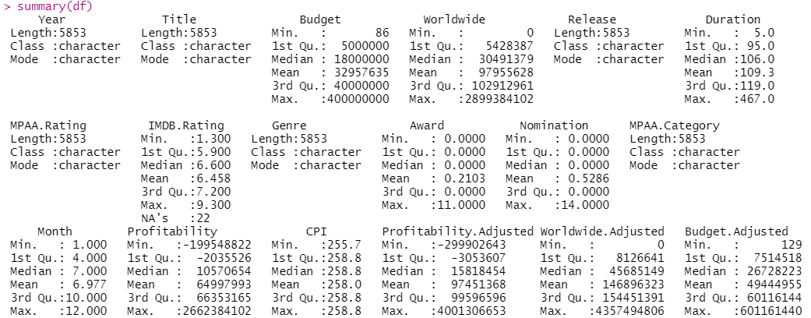
Quick Overview of Data
Notes:
kevin
with that, this is a quick overview of our data, the different columns and their 5 number summary. feel free to pause and take a look

Slide 15
Exploratory Data Analysis (EDA)
Notes:
Hi My name is Joel and I will be taking you through the Exploratory Data Analysis

Slide 16
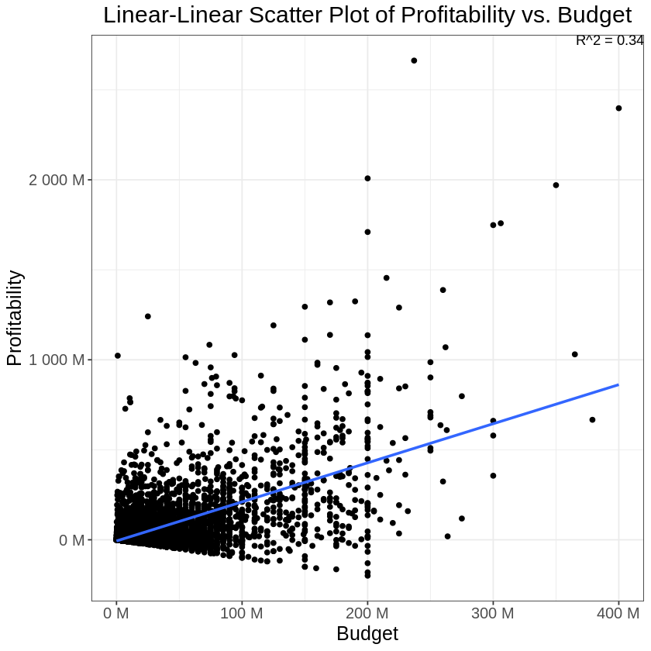
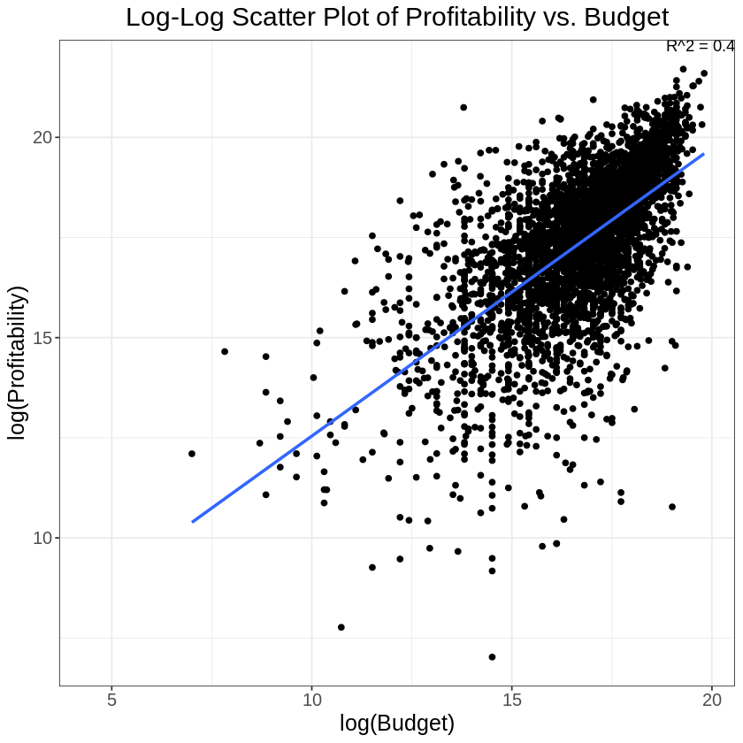
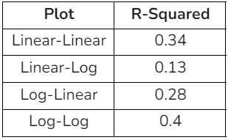
EDA Obs #1 - Heteroscedasticity detected with Lin-Lin plot; Log-Log plot with highest R² value.
Observation 1
Linear -Linear plot shows heteroscedasticity in the data, thus a non-linear plot would be advised. The group adjusted the Profitability and Budget values using the year-on-year CPI values, and plotted all possible logarithmic plots and found the Log-Log plot to have the highest R-squared value. The plot and the summary of model quality can be found below.
EDA: Profit (Unadjusted) Vs Budget (Unadjusted) Scatter Plot
EDA: Profit (Adjusted) Vs Budget (Adjusted) Scatter Plot
Notes:
joel
"We noticed heteroscedasticity in the Linear-Linear plot, so we explored other non-linear plots. After adjusting the data with year-on-year CPI values, the Log-Log plot had the highest R-squared value, making it the optimal choice for our model."

Slide 17
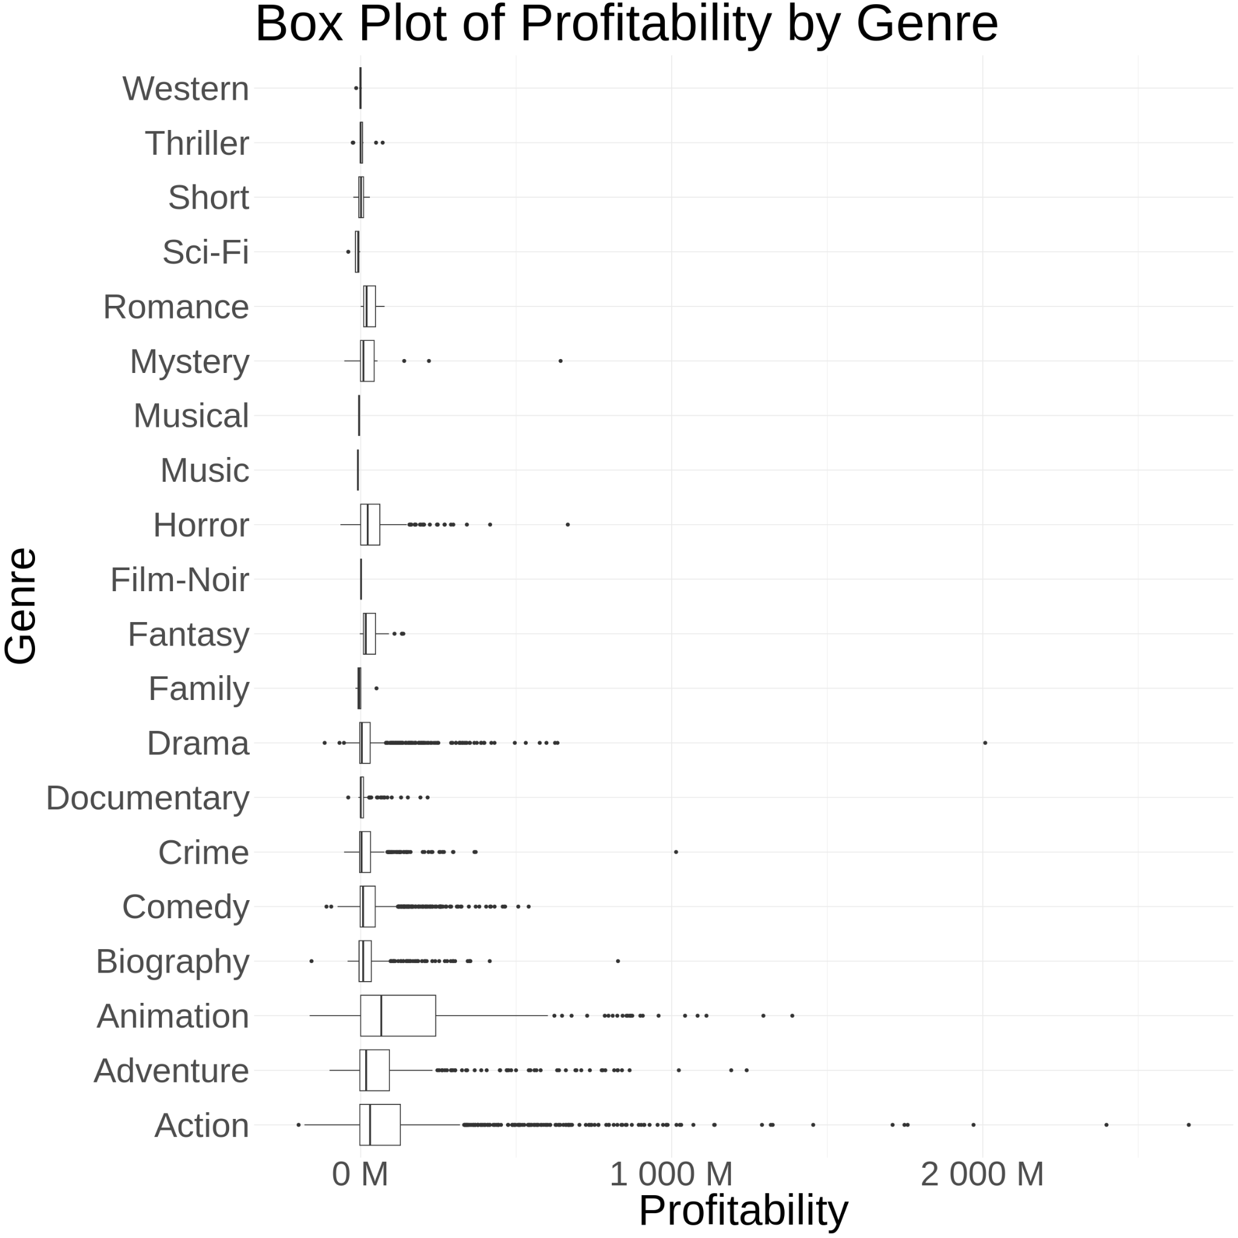
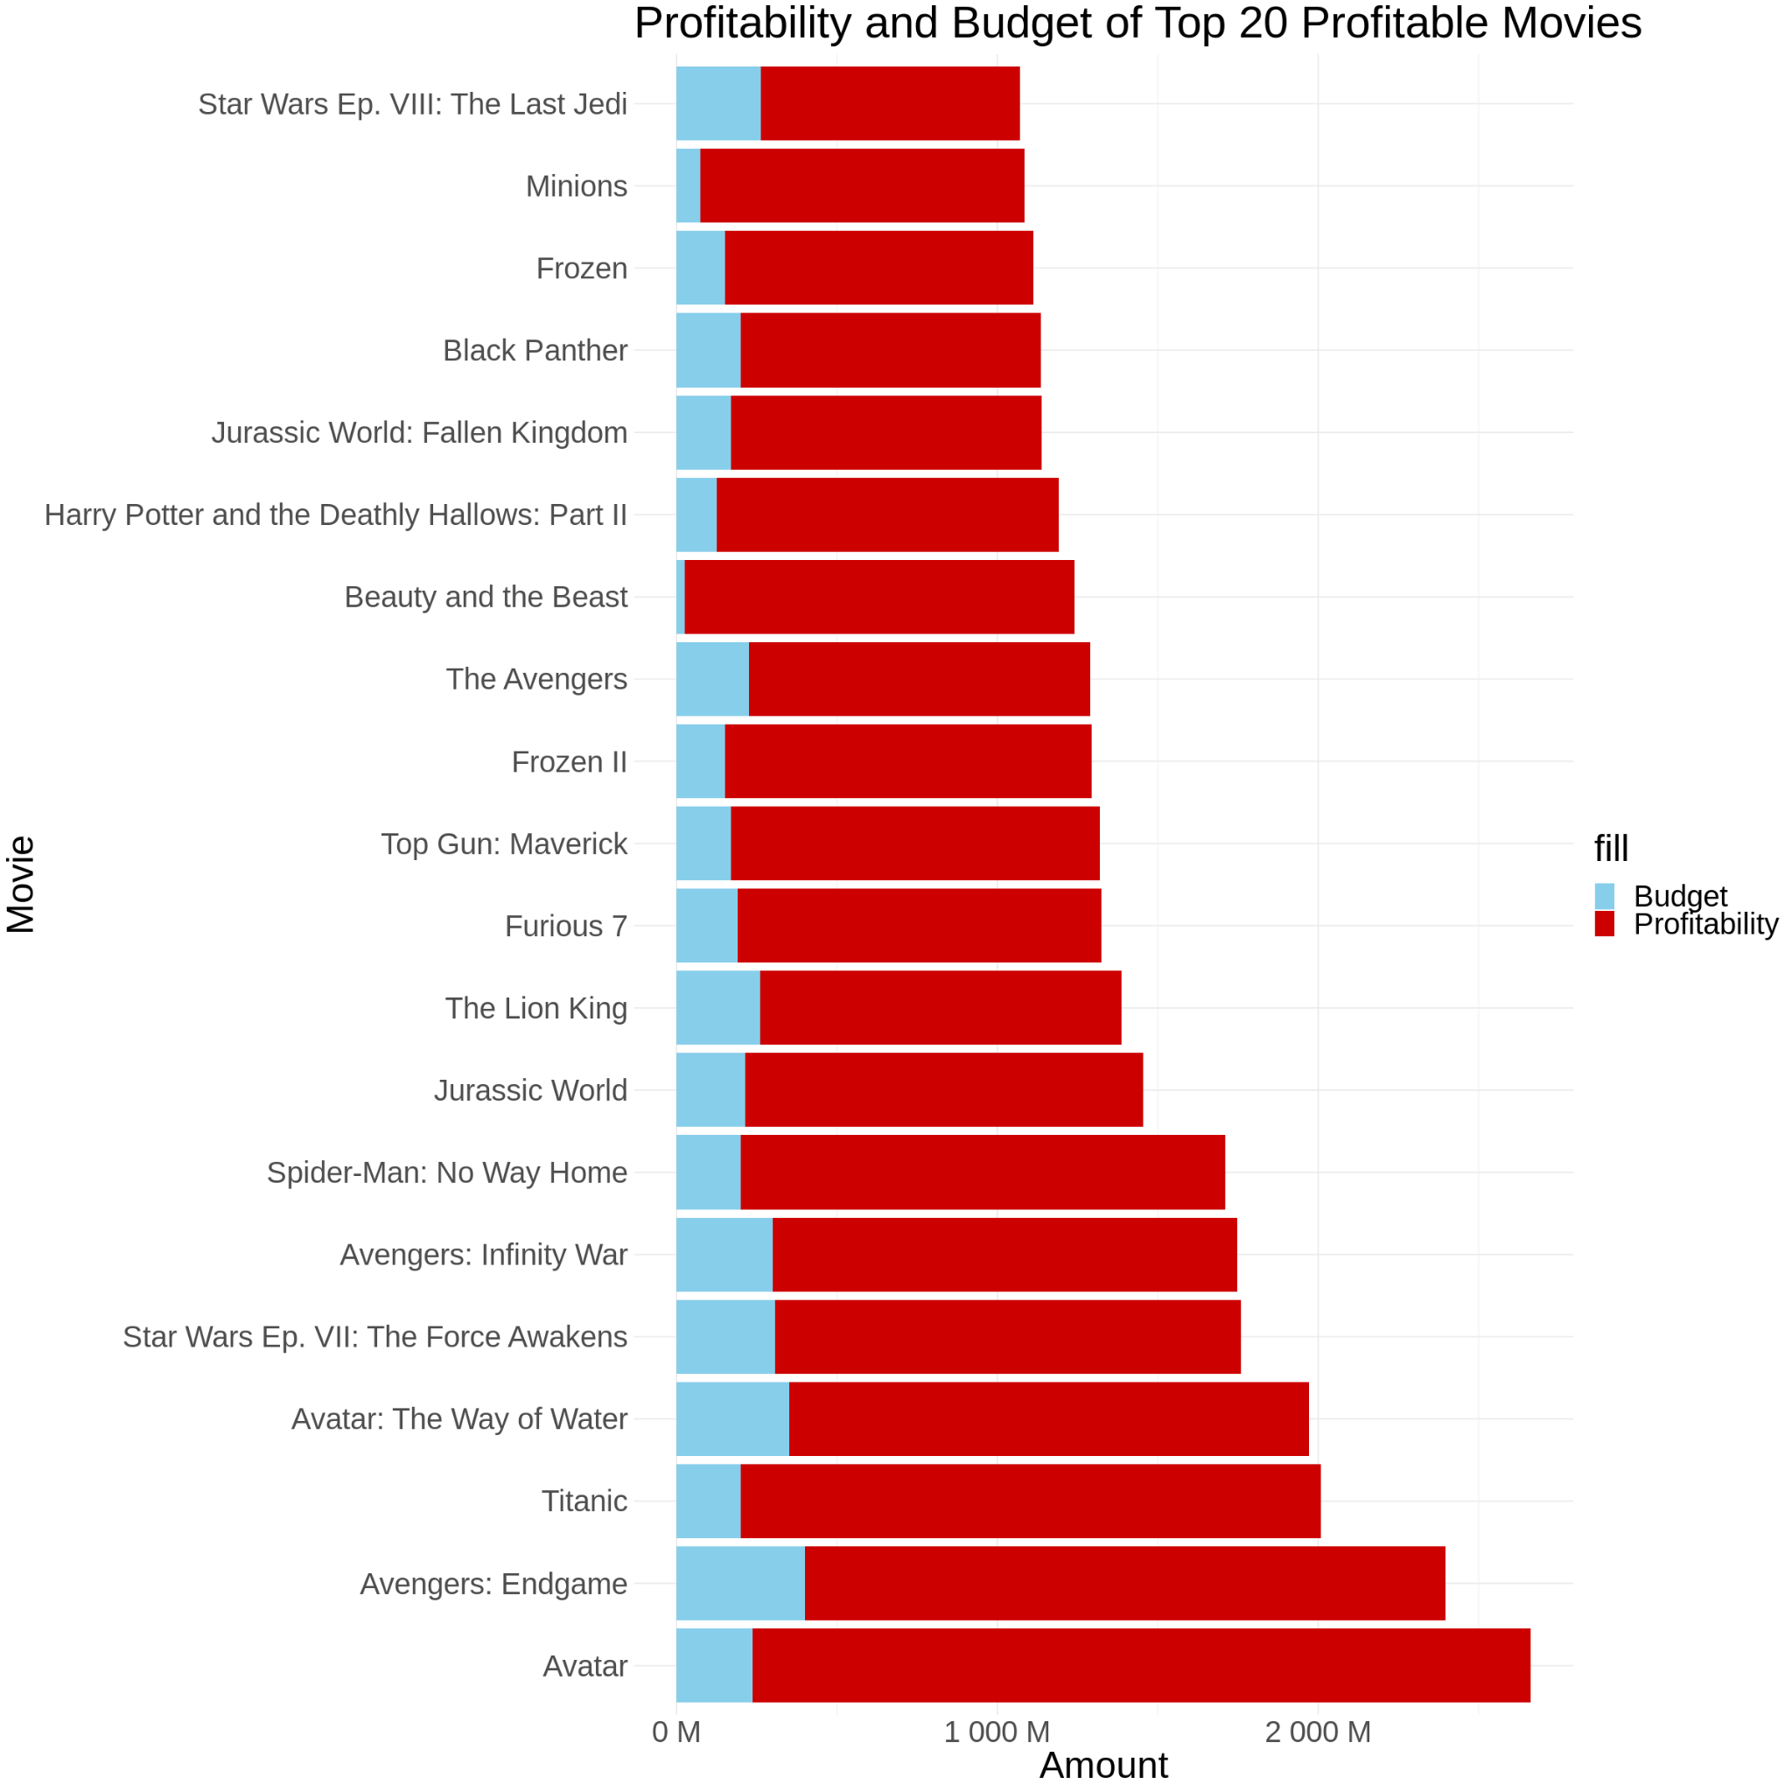
EDA Obs #2 - Action and Adventure top in overall profitability. Animation most profitable genre by median
Observation 2
When comparing profit across genres, animation movies appear to do better based on the five number summaries followed by Action and Adventure. This observation is based on the median and max values of the boxplots.
It appears that the top 20 profitable movies have at least a 10x profit margin. The highest being Beauty and the Beast.
EDA: Boxplots of Budget and Worldwide Gross aggregated by Genres
EDA: Top 20 Movies Profit-Budget Analysis
Notes:
joel
"When analyzing profit across genres, we observed that animation movies outperformed others based on the five number summaries, followed by Action and Adventure genres. The boxplots' median and max values support this finding.
Furthermore, we found that the top 20 profitable movies achieved a minimum of a 10x profit margin, with Beauty and the Beast reaching the highest profit margin among them."

Slide 18

EDA Obs #3 - High initial capital most likely required; Moderate positive relationship between budget and profits
Observation 3
According to the updated correlation heatmap, Budget has a correlation of 0.59 with Profitability, which corroborates with the idea that a higher investment into a movie will lead to higher profitability. Other predictors demonstrate a weaker correlation with Profitability.
EDA: Correlation Heatmap
Notes:
joel
"The latest correlation heatmap reveals that Budget and Profitability are positively correlated with a coefficient of 0.59. This finding supports the notion that increased investment in a movie tends to result in higher profitability. On the other hand, other predictors demonstrate weaker correlations with Profitability."

Slide 19
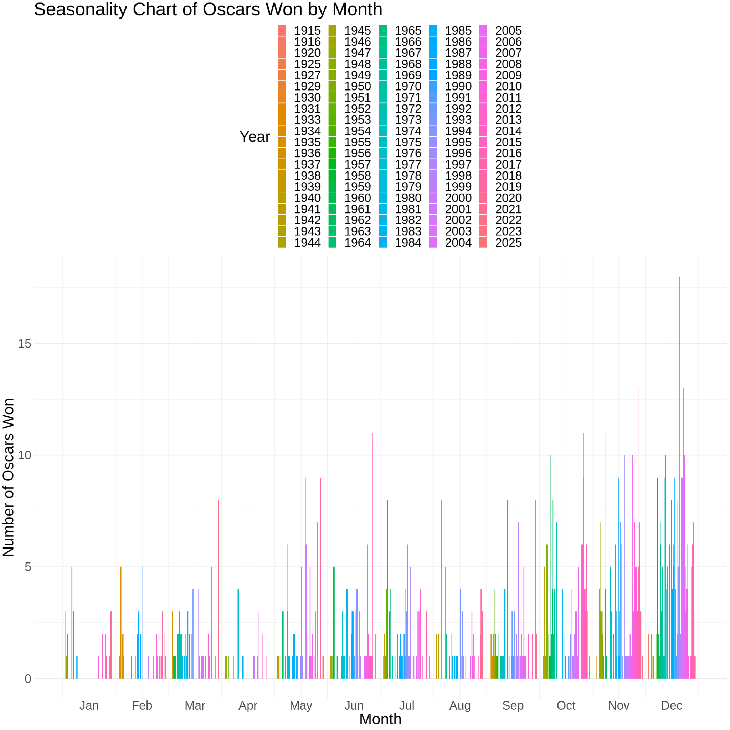
EDA Obs #4 - Movies launched during end year festivals more likely award winning; Jan - Feb & Aug - Sep “Dump months”
EDA: Seasonality Effect on Profitability and Likelihood of Winning An Oscar
Observation 4
From the chart, there seems to be a higher chance of winning an Oscar if the movie is released in December than compared to January.
Notability, Jan, Feb, Aug & Sep has lower Oscars won.
Forbes’ study¹ on this matter corroborate with our findings and noted that these months are referred to as “dump months” where critics expects such movies to be “fillers”
It is clear that to avoid being identified as a low quality film, we should avoid these months to launch a movie
¹Source: The Dump Months: Hollywood's Annual House-Cleaning. Phillips
https://www.forbes.com/sites/scottphillips/2023/01/30/the-dump-months-hollywoods-annual-house-cleaning
Notes:
joel
"Based on the seasonality analysis, movies released in December have a higher likelihood of winning an Oscar compared to those released in January. Additionally, months like January, February, August, and September tend to have lower Oscar-winning frequencies.
These findings align with Forbes' study1, which refers to these months as "dump months," where movies are often perceived as "fillers" by critics. To ensure our movies are not associated with lower quality, it is advisable to avoid releasing them during these months."

Slide 20
Overview of Modeling
Notes:
kevin
Hi I will be going through with our modeling procedure

Slide 21
Model Selection
Choosing the models | The models chosen to answer the business questions included multilinear regression, decision trees and gradient boosting algorithms.
Training the models | Feature selection methods like regularization can be used to reduce the number of input variables prior to modeling. This helps in minimizing model training time and addressing overfitting concerns. Cross-validation techniques were employed during model training to prevent overfitting and reduce selection bias.
Evaluation of models | Depending on the type of problem (classification/regression), the performance of the models will be evaluated using respective metrics. For classification models, we use accuracy, confusion matrix, and AUC. For regression models, we use Root Mean Squared Error (RMSE) and Adjusted R-Squared.
Notes:
kevin
For models used, we used a mix of mutlinear regression, decisions trees, and gradient boosting algorithms based on the specific business question that we had
For training the models, we used regularisation to reduce number of input variables and CV to prevent overfitting and reduce selection bias
to evaluate our models, for classification models, we used accuracy, confusion matrix and AUC. For regression model, we used RMSE and adjusted R2

Slide 22
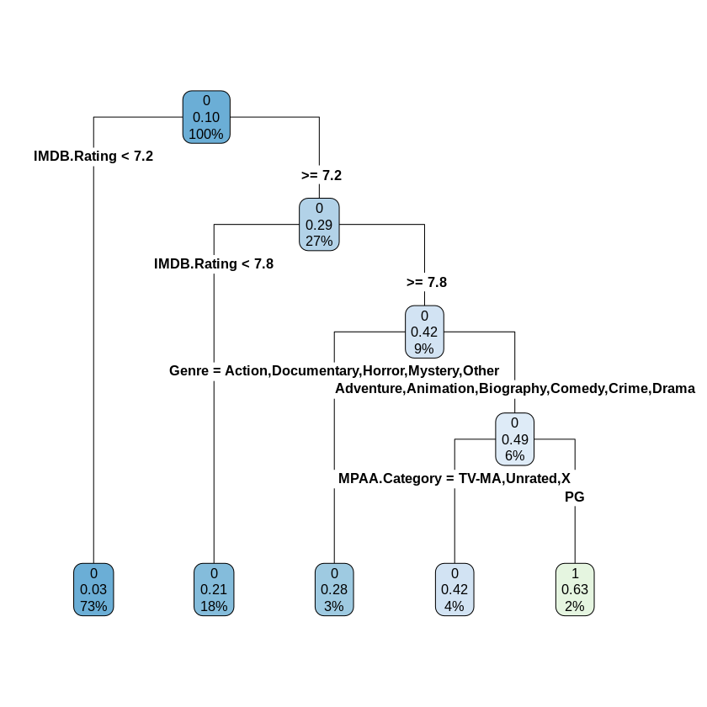
Classification Model 1
Classification Model 1: Classification Tree for Likelihood of Winning an Oscar
Features with Higher likelihood of winning Oscars (63%)
IMDB Rating >7.8
Genre: Adventure, Animation, Biography, Comedy, Crime or Drama
MPAA Rating: PG
Notes:
kevin
for our first classification model, we can see that movies with the following characteristics would have a higher likelihood of winning an oscars

Slide 23
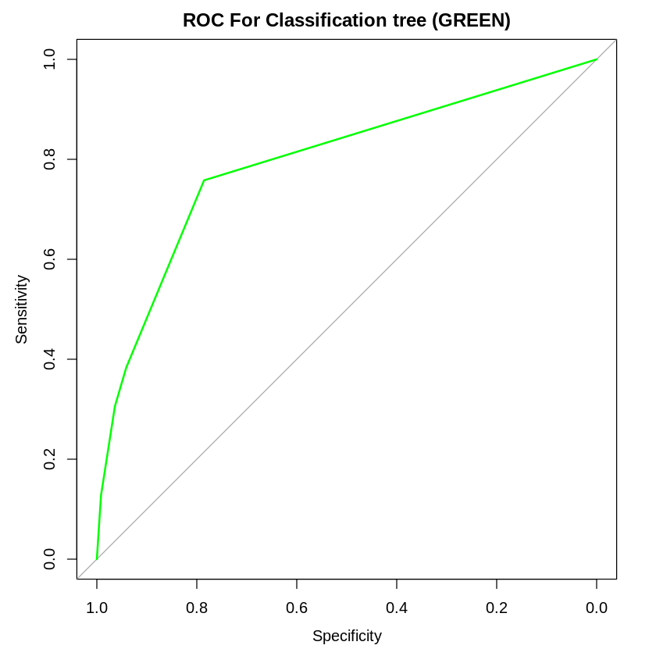
Classification Model 1 (Con’t)
Assessment of Classification Tree Model Quality using ROC/AUC
Accuracy: 0.904; AUC 0.79
 | Actual No Oscar | Actual Win Oscar
Predict No Oscar | 5213 | 44
Predict Win Oscar | 519 | 76
Notes:
kevin
next, this is the ROC curve of our model, it has an AUC of 0.79 and an accuracy of 0.904.

Slide 24
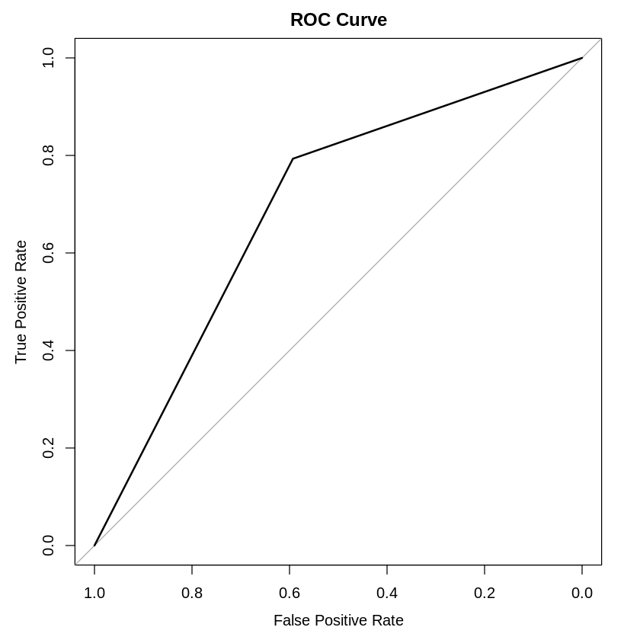
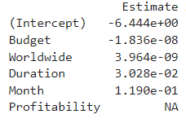
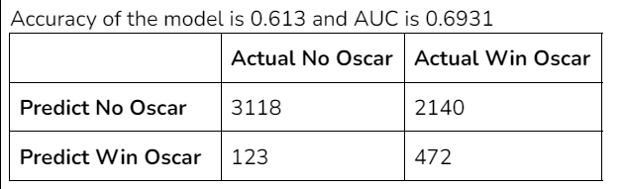
Classification Model 2
Classification Model 2: Logistic Regression for Likelihood of Winning an Oscar | Assess Logistic Regression Model Quality using ROC/AUC
Notes:
wen jun

Slide 25
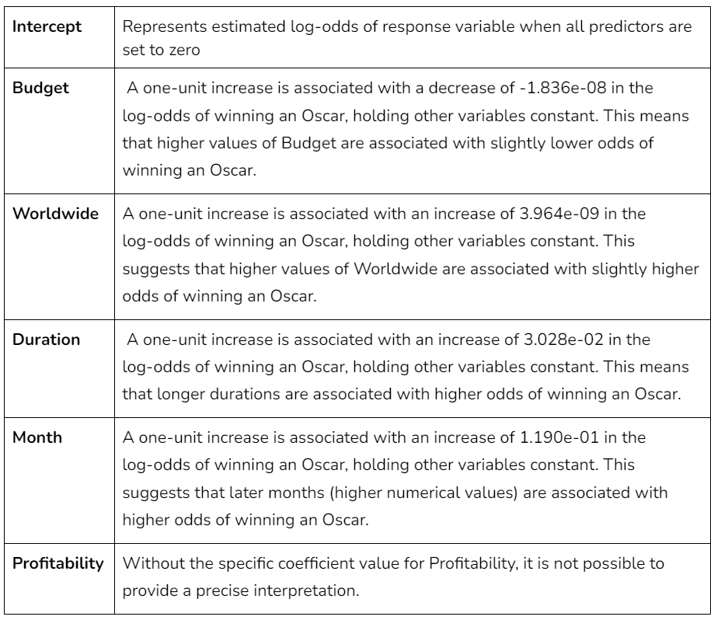
Classification Model 2 (Con’t)
Notes:
wen jun
Budget does not translate directly into oscar
Duration

Slide 26
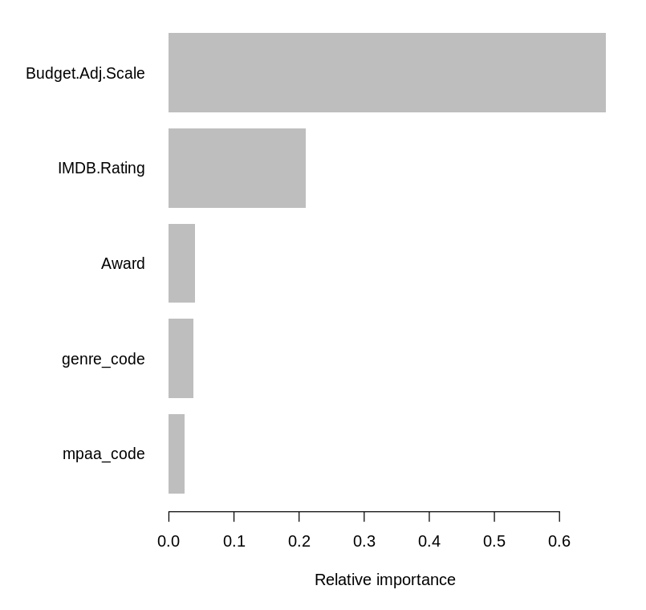
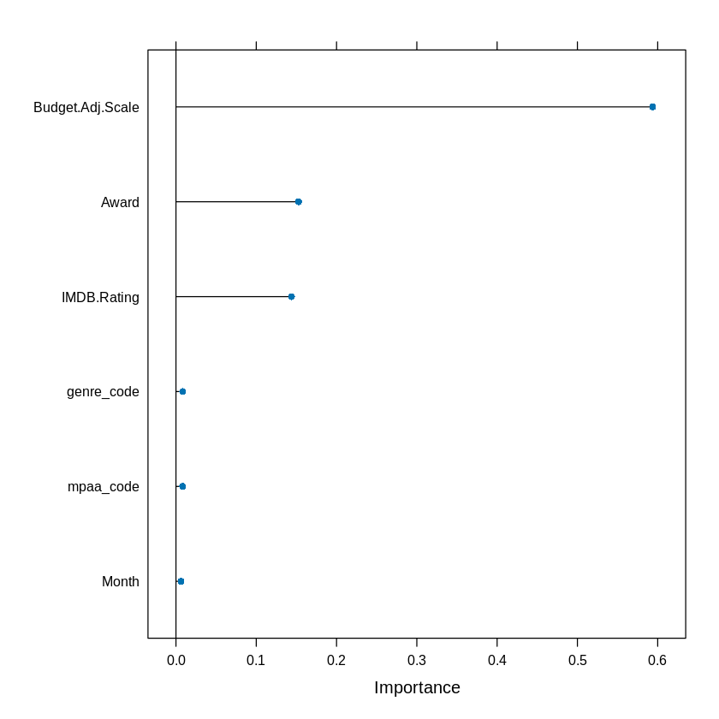
Feature Importance Graph
Elastic Net
XGBoost
Elastic Net Regression and XGBoost models identified significant predictors for profitability
Adjusted Budget, Award, and IMDB Rating found to be influential (different order in two models)
Goal: Provide more accurate figures for predicting monetary success and probability of winning awards for movies.
Notes:
Wei Sin

Slide 27
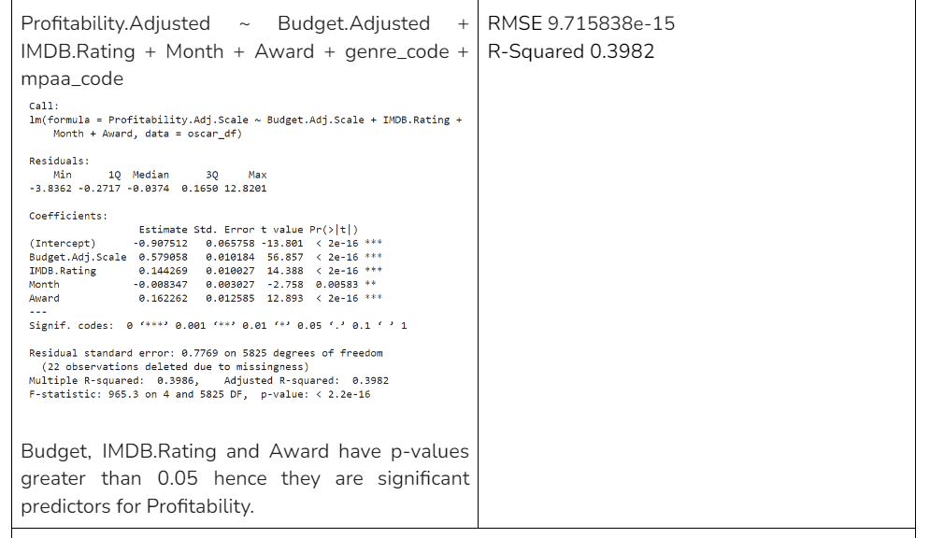
Regression Model 1 - Multilinear Regression on Profitability
Notes:
Wei Sin

Slide 28
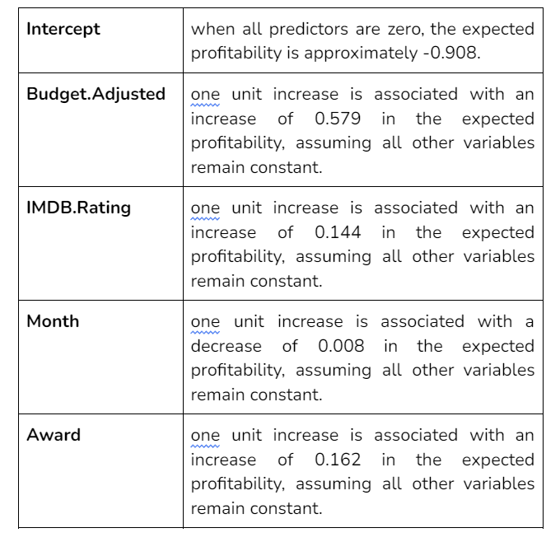
Regression Model 1 - Multilinear Regression on Profitability
Notes:
Wei Sin

Slide 29
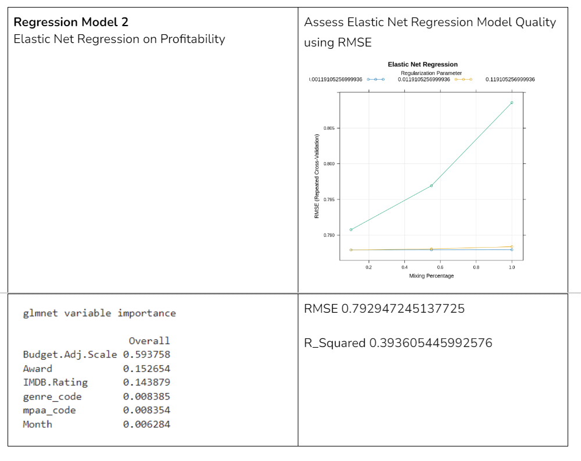
Regression Model 2 - Elastic Net on Profitability
Notes:
Wei Sin

Slide 30
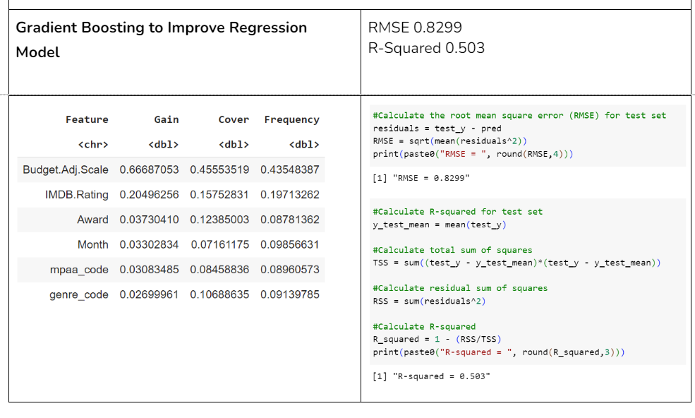
Regression Model 3 - XGBoost on Profitability
Notes:
Wei Sin

Slide 31
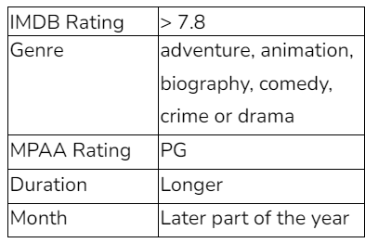
Conclusion
We used four models - Classification Trees, Logistic Regression, Multilinear Regression (Gradient Boosting) and Elastic-Net Regression.
The reason for the model choices is that our team wanted two models for predicting Oscar likelihood, and two models for predicting profitability.
Out of all our models, the Classification Tree performed the best for award prediction & XGBoost best for profitability prediction.
From our model outputs we can conclude the following
The following parameters would help predict profitability the best
B) The following parameters would give the highest likelihood of winning an Oscars (63%).
Budget, IMDB.Rating, Award
All our models affirm our intuition that a higher budget will lead to better Return On Investment (ROI). Also, PG film would mean more accessibility and hence a higher viewership. Also confirmed in our EDA, the later month will contribute to more movie success.
Notes:
Wei Sin

Slide 32
References
Sundaram, S. (2006). Profitability study of MPAA rated movies. Seidman Business Review, 12(1), 6. https://scholarworks.gvsu.edu/cgi/viewcontent.cgi?article=1021&context=sbr
Wallström, K., & Wahlgren, M. (2018). What are the main factors affecting movie profitability? KTH Royal Institute of Technology. https://www.diva-portal.org/smash/get/diva2:1211390/FULLTEXT01.pdf
Hennig-Thurau, T., Houston, M. B., & Walsh, G. (2007). Determinants of motion picture box office and profitability: an interrelationship approach. Review of Managerial Science, 1, 65-92. https://www.marketingcenter.de/sites/mcm/files/downloads/research/lmm/literature/hennig-thurau_et_al._2007_rms_determinants_of_motion_picture_box_office_and_profitability_an_interrelationship_approach.pdf
PricewaterhouseCoopers. (n.d.). Global Entertainment and Media Outlook 2023–2027. PwC.
https://www.pwc.com/gx/en/industries/tmt/media/outlook/insights-and-perspectives.html
The Dump Months: Hollywood's Annual House-Cleaning. Phillips
https://www.forbes.com/sites/scottphillips/2023/01/30/the-dump-months-hollywoods-annual-house-cleaning

